Slide 1
How to Create a Website

Slide 2
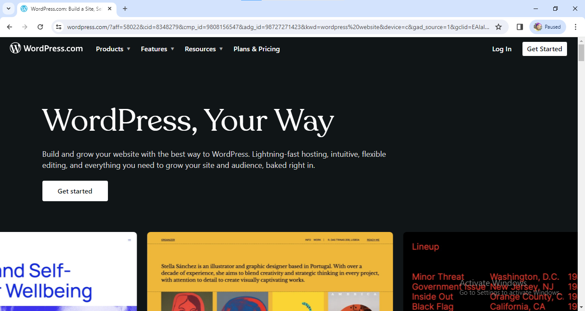
A
Using google chrome ,open the site on Word Press.

Slide 3
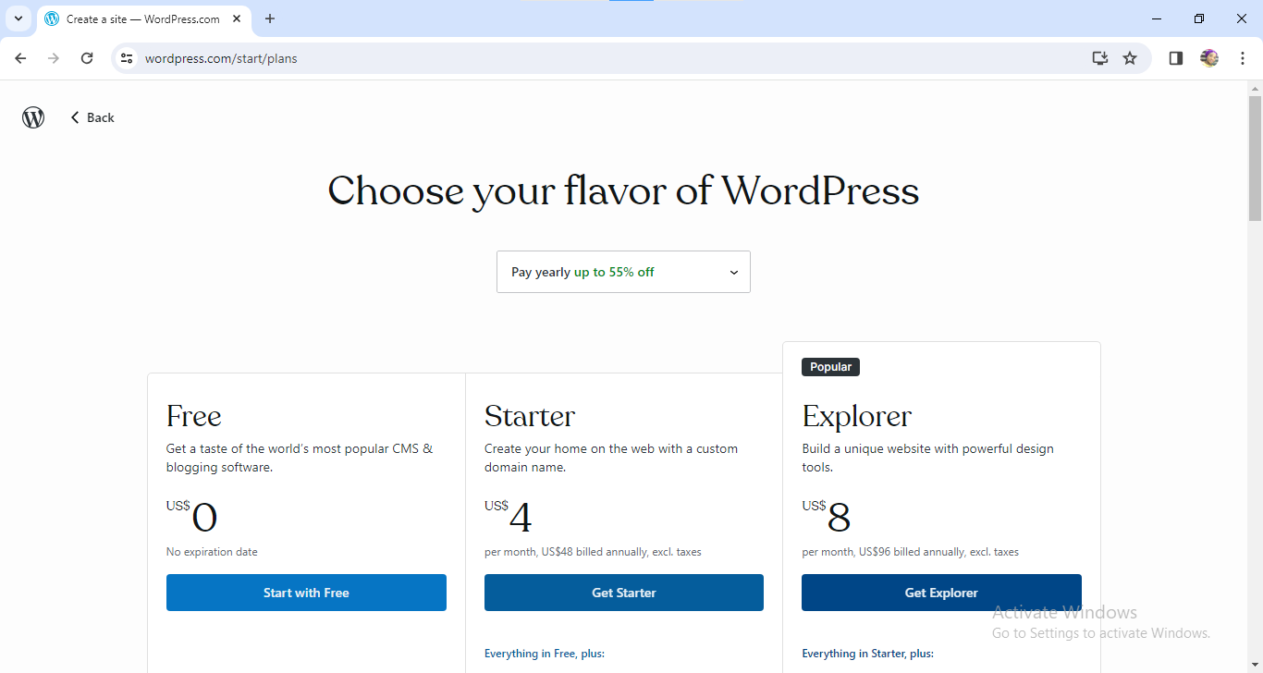
B
Using your flavor of WordPress, register for free on the site

Slide 4
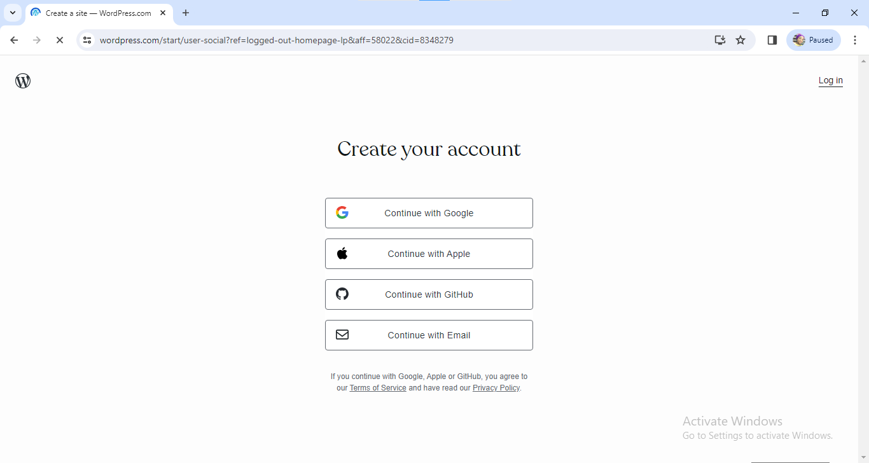
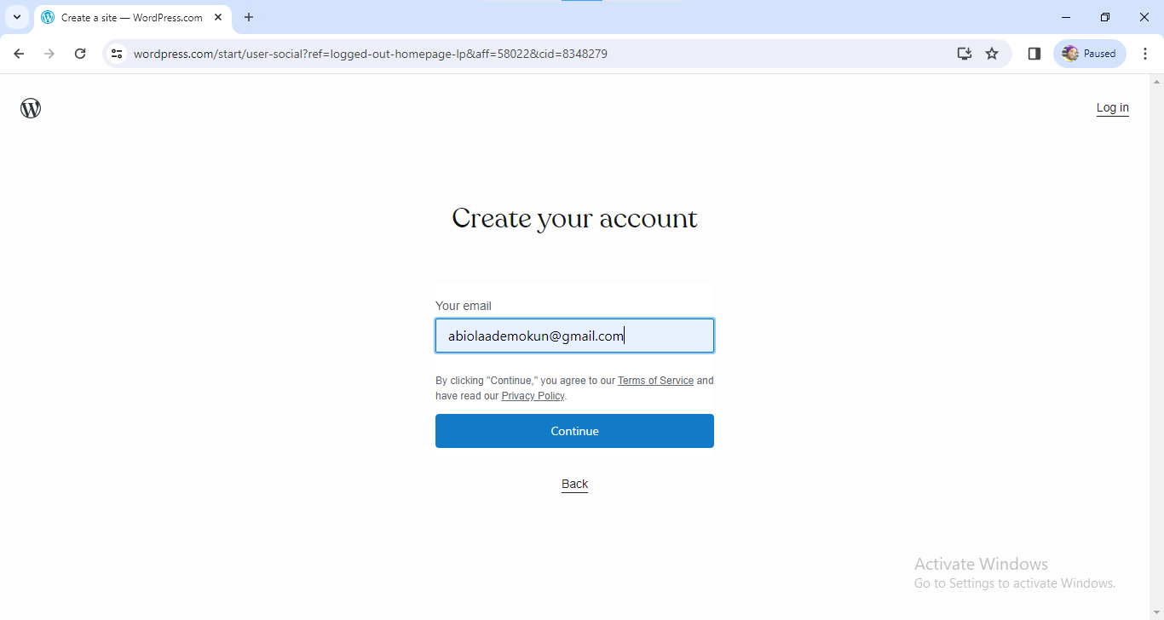
C
Enter your Email Address and it will send a message to your Email verifying the site created

Slide 5
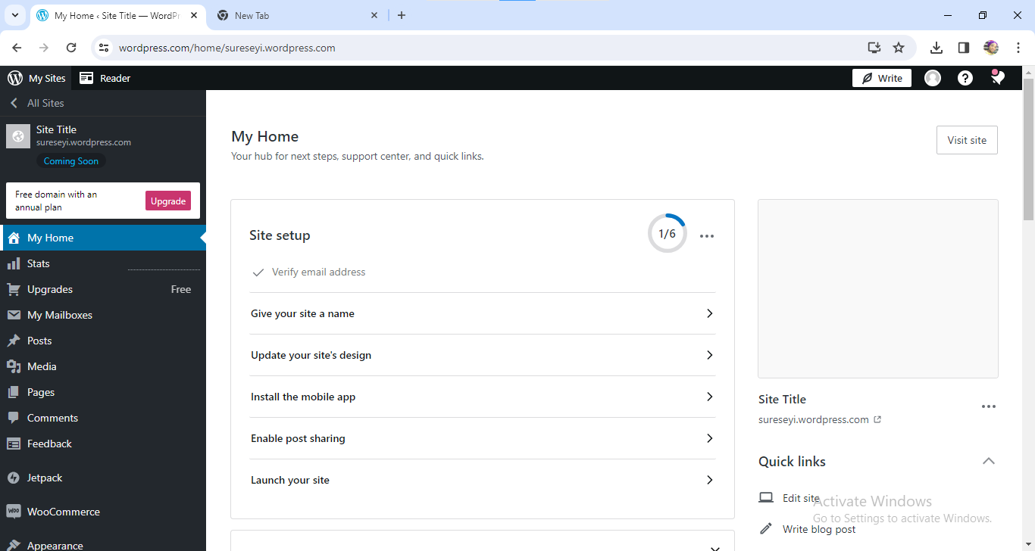
D
After this, you will be directed to the site , there you select your title and category from the title and post section respectively.

Slide 6
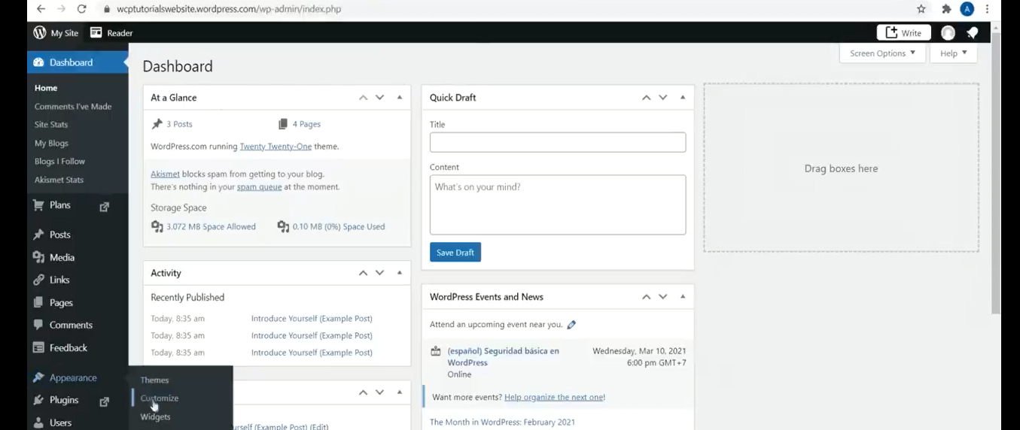
E
Next you click on Theme and choose the type of theme you prefer and customize the theme you choose to the type of words and images you prefer.

Slide 7
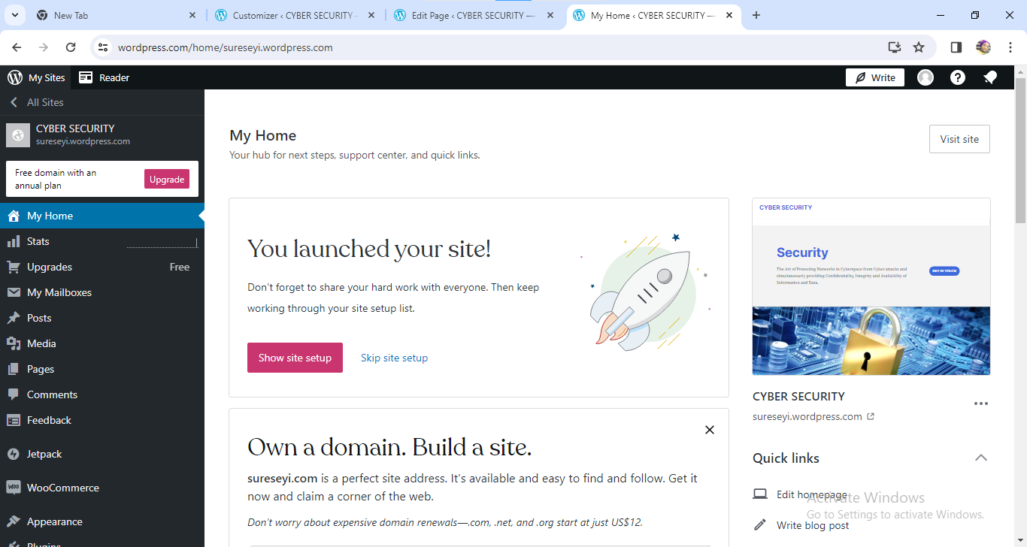
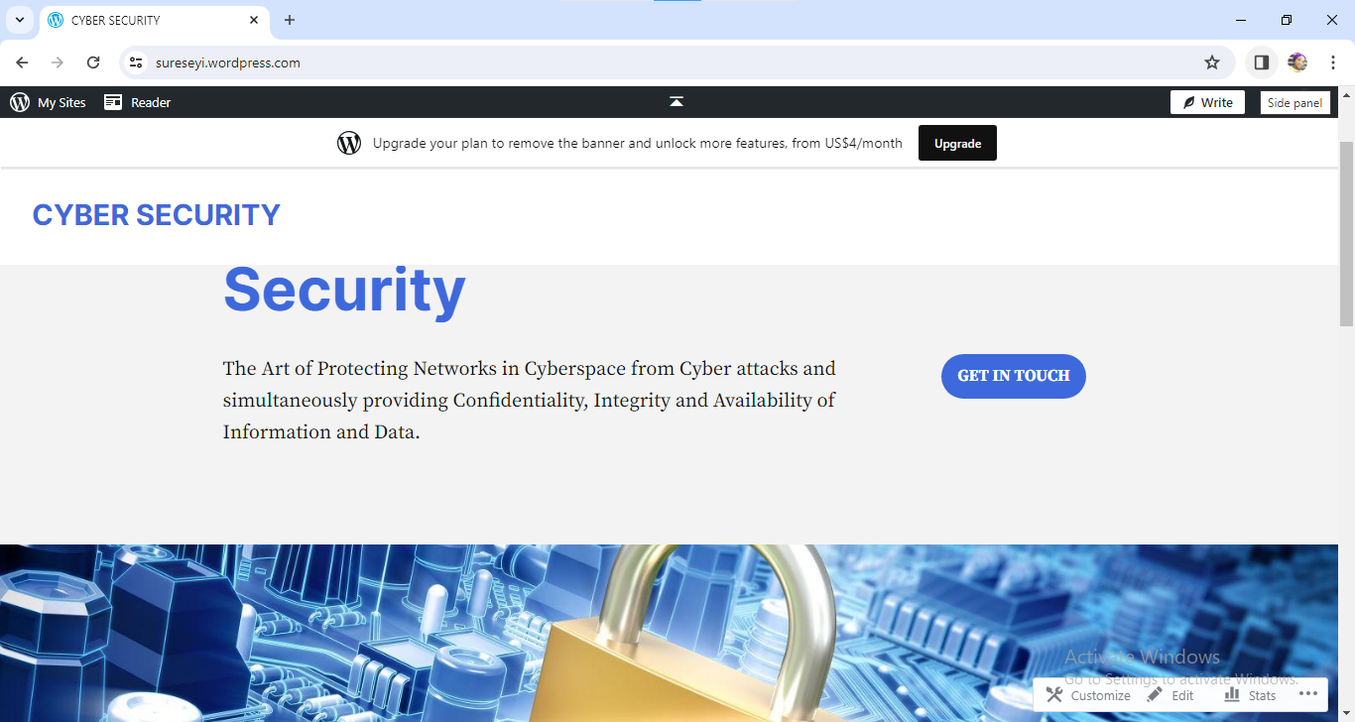
F
Then you go to the top left hand-side of the customized image and launch your site and you have your launched site ready to be used.

